Slide 1

24CSA212 –
Full Stack Frameworks
Request and response handling, error handling and debugging techniques

Slide 2
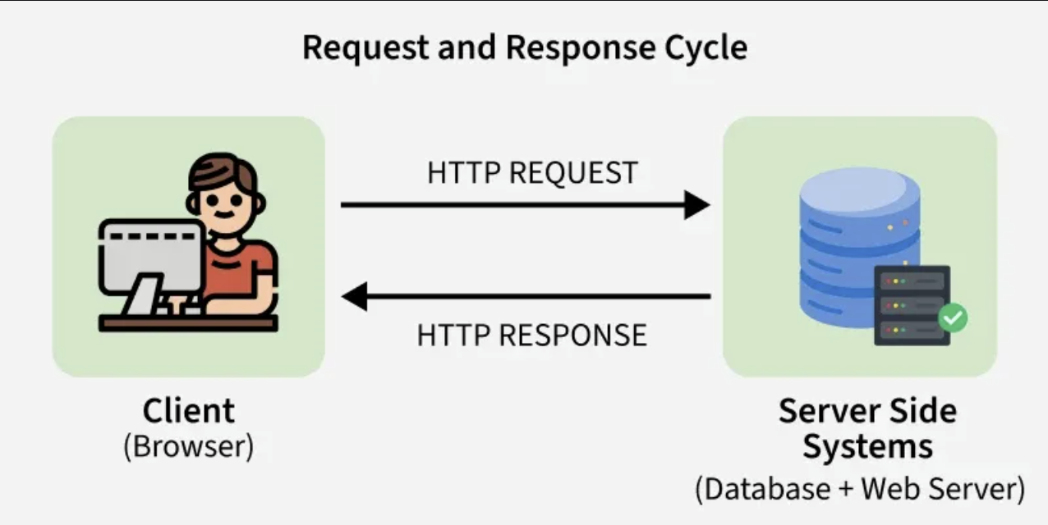
HTTP Request and Response Cycle in Express.js
The HTTP request and response cycle is the backbone of secure communication on the web.
In Express.js, req (request) and res (response) objects are fundamental to handling HTTP requests and sending back responses.
They are passed as arguments to route handlers and middleware functions.
The client, i.e., the browser, will send an HTTP request to the server-side systems( which include a web server and database).
For Example- When you visit a website like https://www.amazon.ac.in/user, your browser will send an HTTP request to the server asking for the user page.
The server processes this request—possibly fetching data from a database—and then sends back an HTTP response, such as an HTML page, which the browser displays to the user.

Slide 3
Basics
In Express.js, every route handler (or middleware) receives two main objects:
req (Request) → Represents the incoming HTTP request.
Contains data like URL, query parameters, body, headers, cookies, etc.
res (Response) → Represents the outgoing HTTP response.
Used to send data, set headers, status codes, and end the request.
Request Object
The Request Object allows you to submit a POST or GET request to a URL.
Essentially, it provides a way to make a REST API request to another URL.
You can also send HEAD, PUT, DELETE, OPTIONS, and PATCH requests.
Commonly Used req Properties
Property Description
req.params Route parameters (e.g., /user/:id)
req.query Query string parameters (e.g., ?name=John)
req.body Request body (requires body-parsing middleware)
req.headers HTTP request headers
req.method HTTP method (GET, POST, etc.)
req.url Full request URL

Slide 4
Response Object
The response object is passed to the second parameter on the request handler, thus we can send to the user a page, an image or download a file.
Commonly Used res Methods
Method Description
res.send() Sends a response (string, object, buffer, etc.)
res.json() Sends a JSON response
res.status() Sets HTTP status code
res.redirect() Redirects to another URL
res.render() Renders a view template.
res.set() Sets response headers
res.end() Ends the response without data

Slide 5
Methods to Send Request to Server
1. Client Sends a Request
The cycle starts when a clients - such as browser , mobile app or API testing tool(like postman)- sends an HTTP request to the server.
This request includes:
1. HTTP method(e.g GET, PUT, POST, DELETE)
2. URL/EndPoint(e.g, /users, /products/1)
3. Headers(e.g, content-type, authorization)
4.Optional Data(like form-data, or JSON in the request body)
2. Express Recieves the Request
Express.js listen for incoming requests on specified routes and HTTPS methods. It matches the request to the appropriate route handler

Slide 6
3. Middleware Processing
Before Reaching the router handler, the request can pass through one or more middleware functions. Middleware can modify the req (request) or perform actions like authentication , logging, or parsing data.
4. Route Handler Executes
The matched route executes its callback function, where you can access request data(req) and prepare a response object using the res object.
5. Server Sends a Response
Using the res object , Express sends the response back to the client. You can send plain text, JSON , HTML or status code.
6. Cycle Completes
Once the response is sent , the cycle ends. The client receives the result, and may act on it or display it to the user.

Slide 7
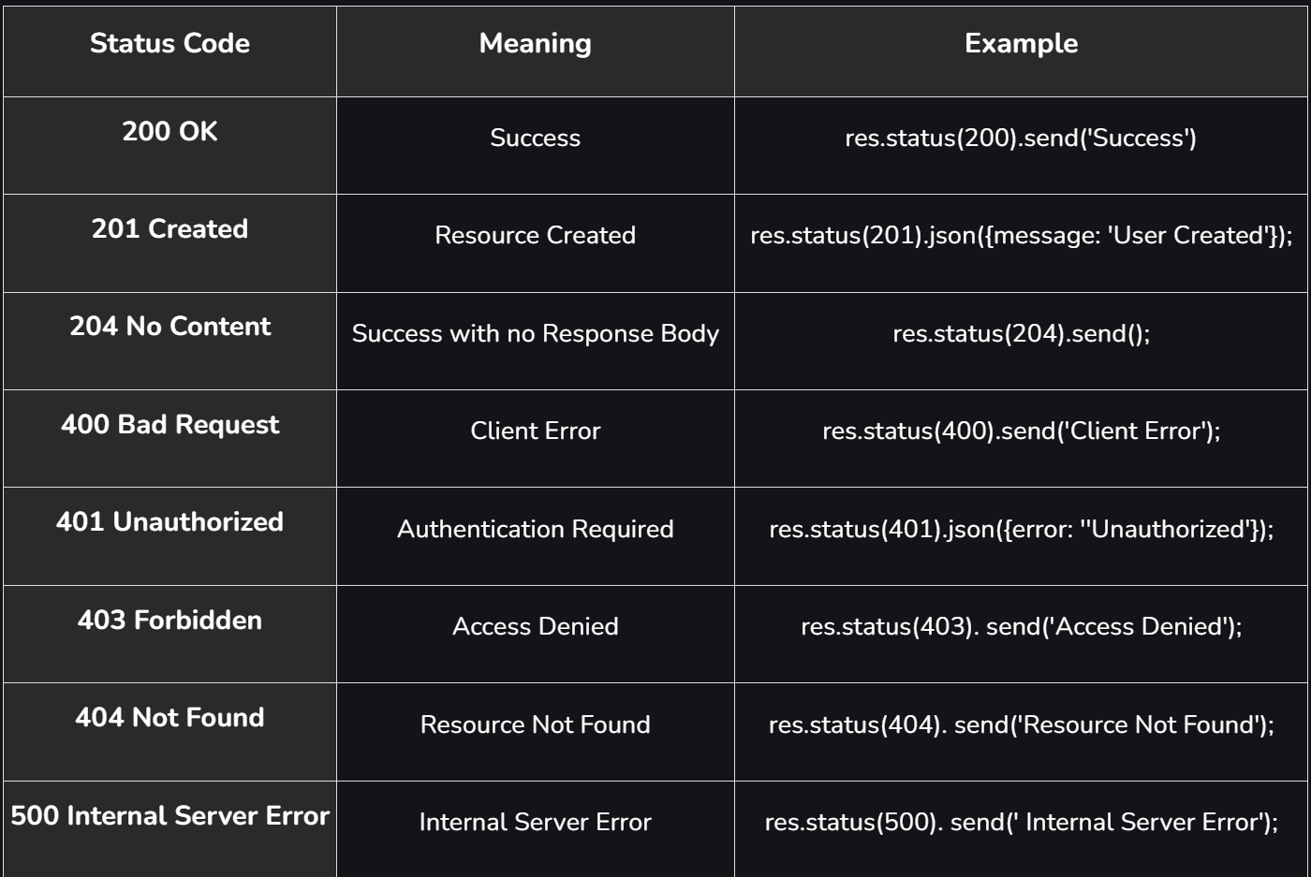
Status Code
When a server responds to client request in Express.js , it returns more than just a data - it also checks an HTTP Status code.
These codes are 3- digit numbers that indicates the result of the request.
It helps the client to understand whether the request is successful, failed or requires further action.
To use appropriate status code improves communication between client and server, enhances debugging and ensures better API design.
Common HTTP Status Code and their Usage in Express.js

Slide 8
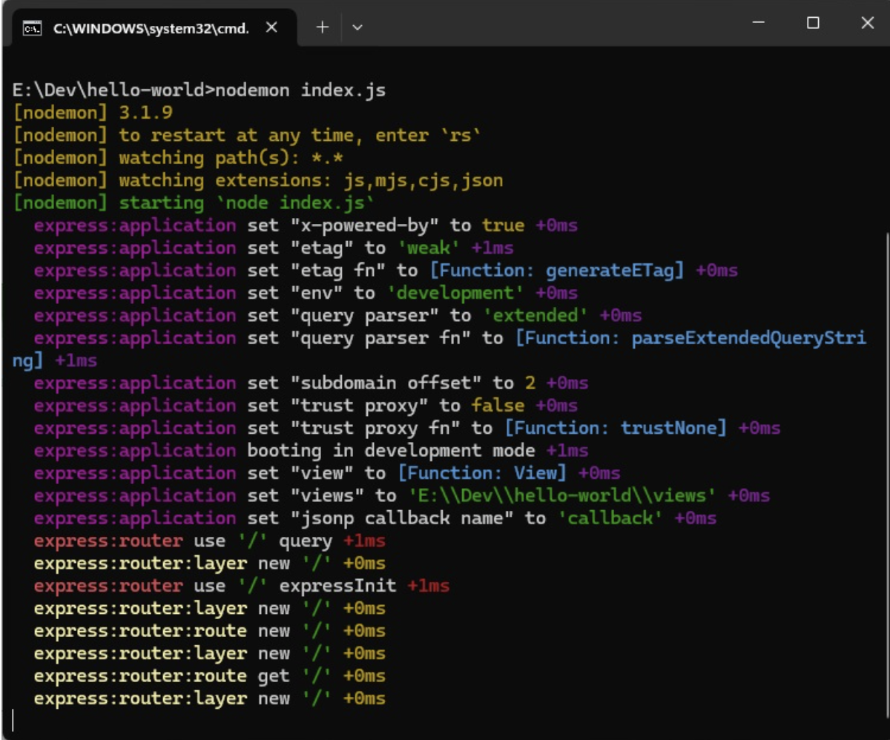
Debugging techniques in Express.js
Use the Built-in debug Module
Express internally uses the debug package for logging.
You can enable it by setting the DEBUG environment variable.
npm install debug
To see all internal logs used in Express, set the DEBUG environment variable to Express:* when starting the app −
Example:
# Enable only router logs
DEBUG=express : router node app.js
Common namespaces:
express:* → All logs
express:router → Router-level logs
express:application → App-level logs
# Enable all Express debug logs
DEBUG=express:* node app.js
Example: E:\Dev\hello-world>set DEBUG=express:*
E:\Dev\hello-world>nodemon index.js
The following output will be displayed.
These logs are very helpful when a component of your app is not functioning right. This verbose output might be a little overwhelming. You can also restrict the DEBUG variable to specific area to be logged. For example, if you wish to restrict the logger to application and router, you can use the following code.
DEBUG = express:application, express:router node index.js
Debug is turned off by default and is automatically turned on in production environment.

Slide 9
Debugging techniques in Express.js
2. Use console.log() Strategically
While basic, console.log() is still useful for quick checks.
Use console.error() for errors.
Use console.table() for structured data.
Remove or comment them out in production.
3. Use Node.js Inspector for Step-by-Step Debugging
Node.js has a built-in debugger.
node --inspect app.js
Then open chrome://inspect in Chrome and attach to the process.
You can set breakpoints, step through code, and inspect variables.

Slide 10
Debugging techniques in Express.js
4. Use VS Code Debugger
Create .vscode/launch.json:
{
"version": "0.2.0",
"configurations": [
{
"type": "node",
"request": "launch",
"name": "Debug Express App",
"program": "${workspaceFolder}/app.js"
}
]
}
Press F5 to start debugging with breakpoints.

Slide 11
Debugging techniques in Express.js
5. Use Middleware for Request/Response Logging
Install morgan for HTTP request logging:
npm install morgan
Example:
const express = require('express');
const morgan = require('morgan');
const app = express();
app.use(morgan('dev')); // Logs method, URL, status, response time
app.get('/', (req, res) => res.send('Hello World'));
app.listen(3000, () => console.log('Server running on port 3000'));

Slide 12
Debugging techniques in Express.js
6. Handle Errors with Custom Middleware
Express error-handling middleware helps catch and log errors.
Example:
app.use((err, req, res, next) => {
console.error(err.stack);
res.status(500).json({ error: 'Something went wrong!' });
});
7. Use nodemon for Auto-Restart
npm install --save-dev nodemon
nodemon app.js
This restarts the server automatically on file changes, speeding up debugging.

